Slide 1

Introduction to Python
Python is a high-level, interpreted programming language.
• Created by Guido van Rossum and released in 1991.
• Known for simplicity and readability.
• Widely used in web development, data science, AI, automation, and more.

Slide 2
Features of Python
Easy to learn and use
Interpreted language
Object-Oriented
Cross-platform
Large standard library
Dynamic typing

Slide 3
Applications of Python
• Web Development (Django, Flask)
• Data Science and Machine Learning
• Automation and Scripting
• Game Development
• Cyber Security
• Software Development

Slide 4
Installing Python
• Download Python from: https://www.python.org
• Install Python and set environment variables
• Verify installation using command: python --version

Slide 5
First Python Program
Example:
print('Hello, World!')
print() is used to display output on the screen.

Slide 6
Python: Syntax & Basics
Master the fundamental building blocks of Python programming, from variables and data types to control flow and data structures.

Slide 7
Understanding Variables
What Are Variables?
age = 25
name = "Saurabh"
is_student = True
# Variables can change
age = 26
name = "Suman"
A variable is a named container that stores data in your computer's memory. Unlike many other languages, Python doesn't require you to declare data types explicitly—it infers them automatically based on the value you assign.
Variables make your code flexible and reusable, allowing you to store and manipulate information throughout your programme.

Slide 8
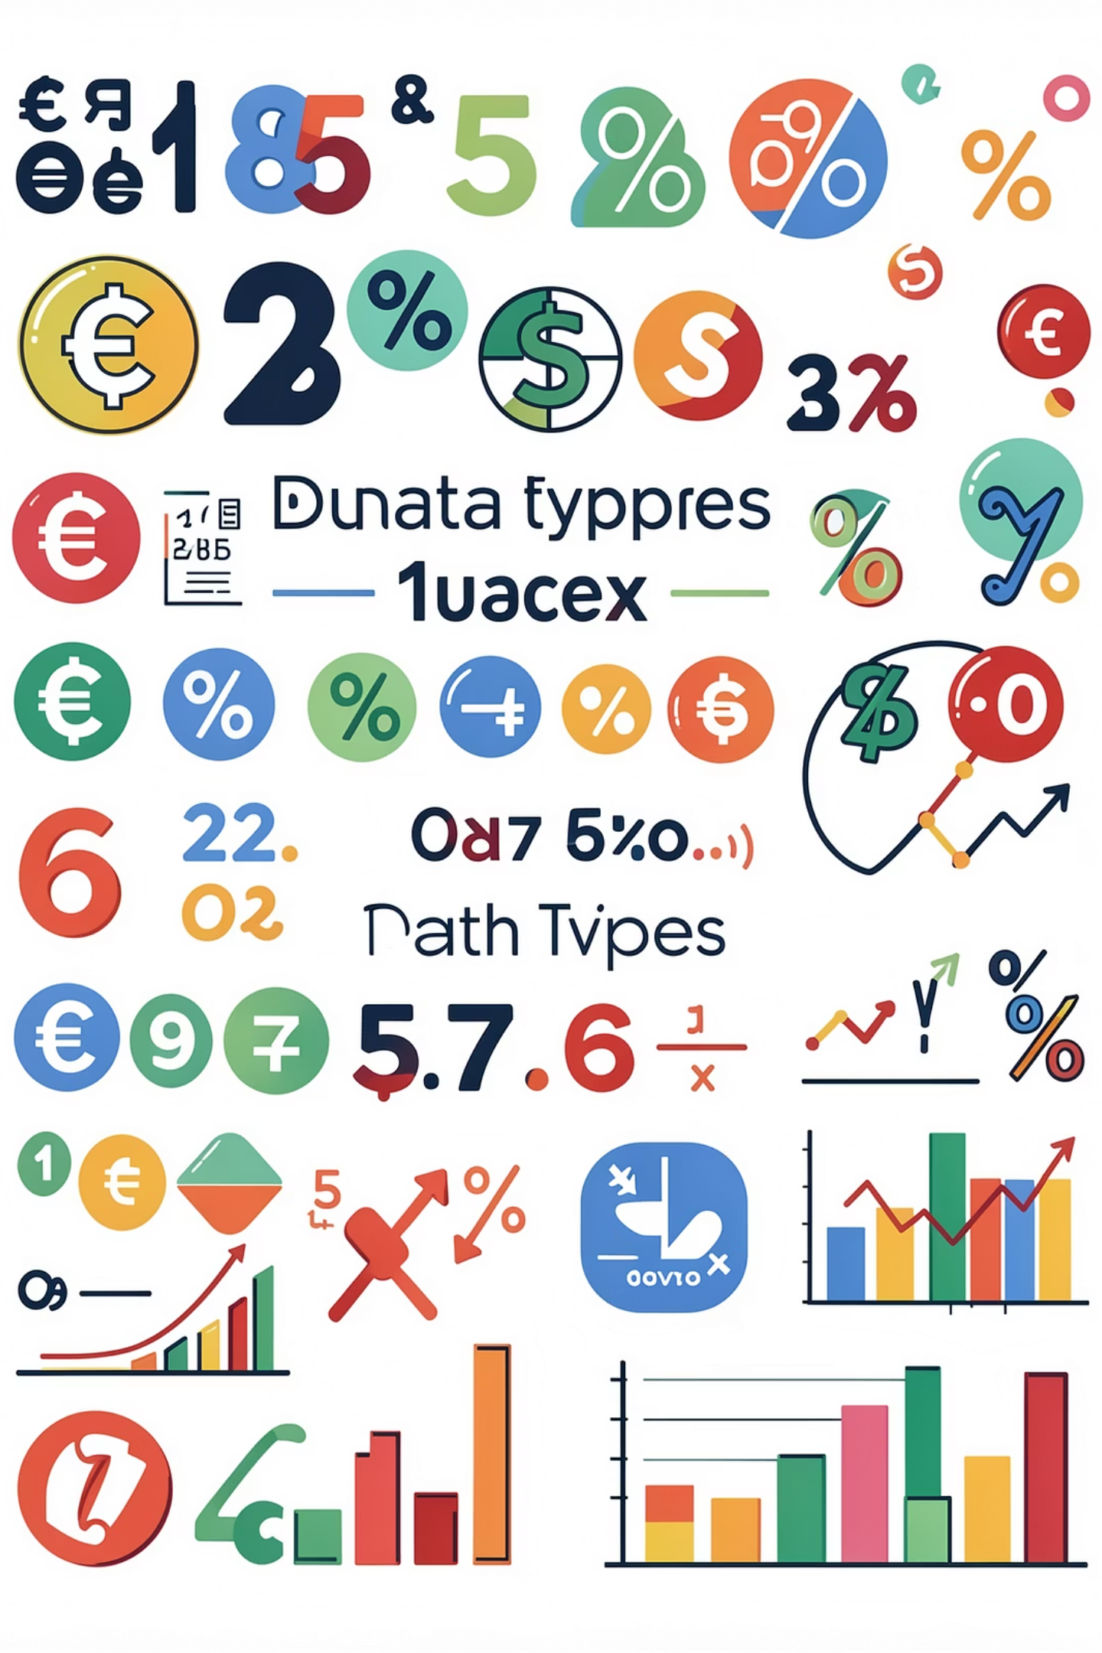
Data Types in Python
Data types define what kind of value a variable can hold. Python's flexibility comes from its dynamic typing system.
int
float
str
Whole numbers without decimals
Numbers with decimal points
Text enclosed in quotes
marks = 90
salary = 55000.75
course = "Python"
bool
True or False values
passed = True

Slide 9
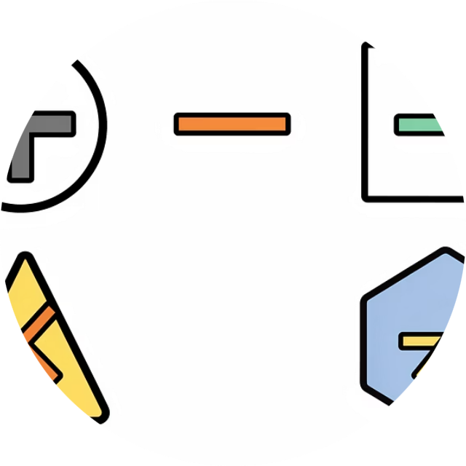
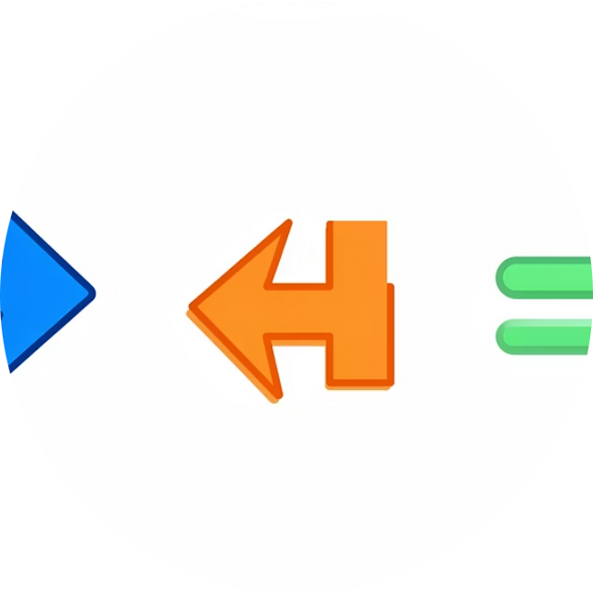
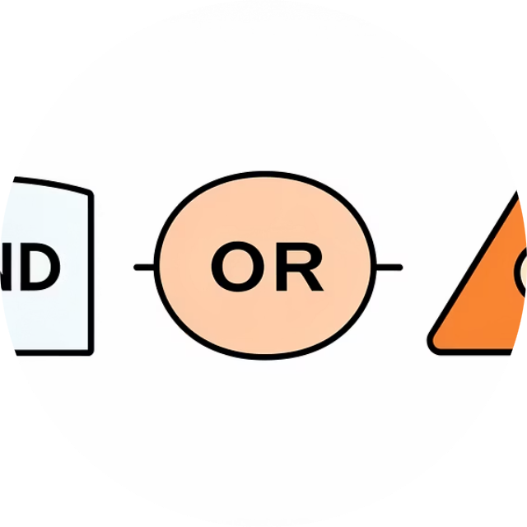
Working with Operators
Operators are symbols that perform operations on variables and values. They're the building blocks for mathematical calculations, comparisons, and logical decisions.
Arithmetic
Relational
Logical
Perform calculations: + - * / %
Compare values: > < == !=
Combine conditions: and or not
a = 10
b = 5
print(a + b) # 15
print(a > b) # True
print(a == b) # False
print(a > 5 and b < 10)
# True

Slide 10
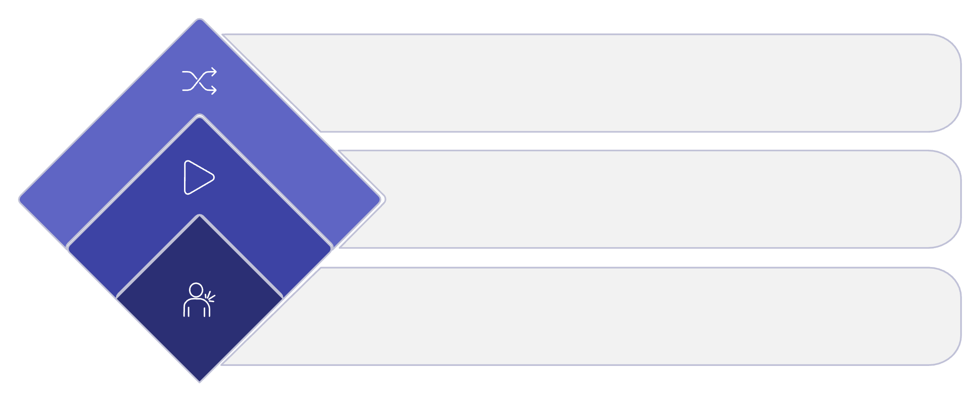



Control Flow: Making Decisions
Conditional Statements
Use if-elif-else to execute different code blocks based on conditions. This is fundamental for creating responsive, intelligent programmes.
False → Alternative
Execute alternate branch
True → Action
Execute primary branch
age = 18
if age >= 18:
print("Eligible to vote")
elif age >= 16:
print("Almost there!")
else:
print("Not eligible")
Check Condition
Evaluate boolean expression
Control flow structures allow your programme to make decisions and respond to different conditions dynamically.

Slide 11

Loops: Repeating Actions
Loops allow you to execute a block of code multiple times, making your programmes efficient and reducing repetitive code.
for Loop
whilst Loop
Iterate over a sequence or range of values. Perfect when you know how many times to repeat.
Continue looping whilst a condition is true. Ideal when the number of iterations depends on a condition.
for i in range(1, 6):
print(i)
# Output: 1 2 3 4 5
i = 1
while i <= 5:
print(i)
i += 1

Slide 12
Data Structures: Lists & Tuples
List
Tuple
An ordered, mutable collection that allows duplicate values. Lists are versatile and can be modified after creation.
An ordered, immutable collection that cannot be changed after creation. Tuples are faster and more memory-efficient than lists.
languages = ["Python", "Java", "C++"]
languages.append("Go")
print(languages)
coordinates = (10, 20)
print(coordinates[0]) # 10
# coordinates[0] = 15 # Error!
Use lists when you need to add, remove, or change elements frequently.
Use tuples for data that shouldn't change, like coordinates or configuration values.

Slide 13

Data Structures: Dictionaries & Sets
Dictionary
Stores data in key-value pairs, allowing fast lookups by key. Perfect for structured data like user profiles or configuration settings.
student = {
"id": 101,
"name": "Rahul",
"course": "Python"
}
print(student["name"])
Set
An unordered collection that stores unique elements only. Automatically removes duplicates and supports mathematical operations.
numbers = {1, 2, 3, 3, 4}
print(numbers) # {1, 2, 3, 4}

Slide 14
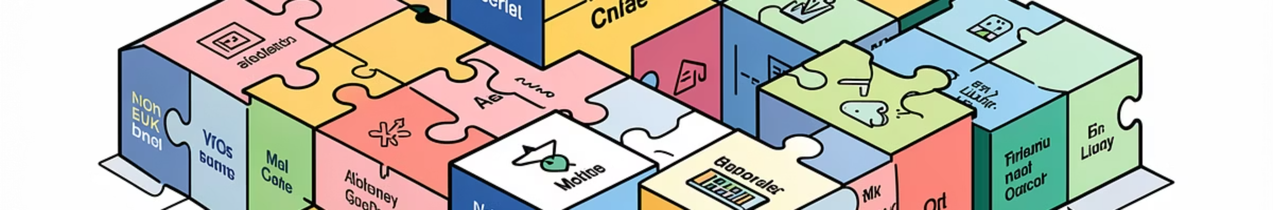
Functions & Modules
Functions
Modules
A reusable block of code that performs a specific task. Functions help you organise code, avoid repetition, and make programmes easier to maintain.
A file containing Python code (functions, variables, classes) that you can import and reuse. Python's extensive standard library provides modules for almost everything.
def add(a, b):
return a + b
result = add(10, 5)
print(result) # 15
import math
print(math.sqrt(25)) # 5.0
print(math.pi) # 3.14159...

Slide 15
Error Handling & Debugging
Robust programmes anticipate and handle errors gracefully, preventing crashes and providing helpful feedback to users.
Common Python Errors
try:
num = int(input("Enter number: "))
result = 10 / num
print(result)
except ValueError:
print("Invalid input! Please enter a number.")
except ZeroDivisionError:
print("Cannot divide by zero!")
finally:
print("Execution completed.")
SyntaxError: Incorrect Python syntax
NameError: Variable not defined
TypeError: Wrong data type used
ZeroDivisionError: Division by zero
Exception Handling
Use try-except blocks to catch and handle errors without crashing your programme.
The finally block always executes, whether an error occurs or not—perfect for cleanup operations.

